Slide 1
Dynamics of a sparsely connected balanced network
Bachelor Thesis Psychobiology
Jiri Brummer
Supervised by Fleur Zeldenrust
18-6-2015

Slide 2
Outline
Introduction
What is a balanced network
Previous studies
Methods
Implementation
Analysis
Results
Discussion

Slide 3
Introduction

Slide 4
Background information
Cortical cells show irregular firing
Computational models
Balanced network
Can reach a Asynchronous Irregular state
Leaky Integrate-and-Fire neurons
Notes:
Ooit begonnen met onderzoek naar irregular firing dmv computational models, daarna computational neuroscience vakgebied an sich en daarmee ook de eigenschappen van een balanced network

Slide 5
Leaky Integrate-and-Fire (LIF) neurons
Computational powerful
Easy to analyze
Very few parameters

Slide 6
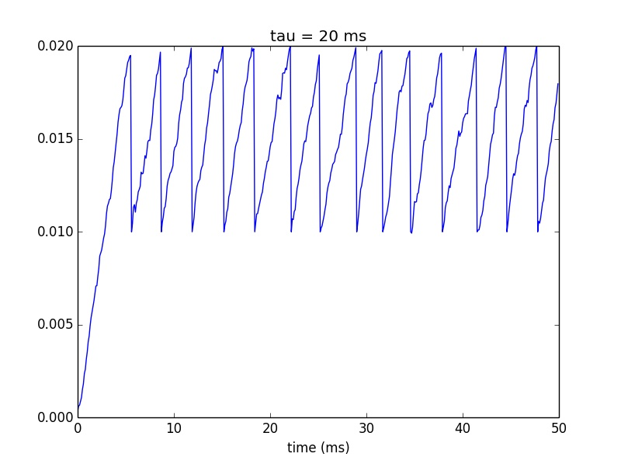
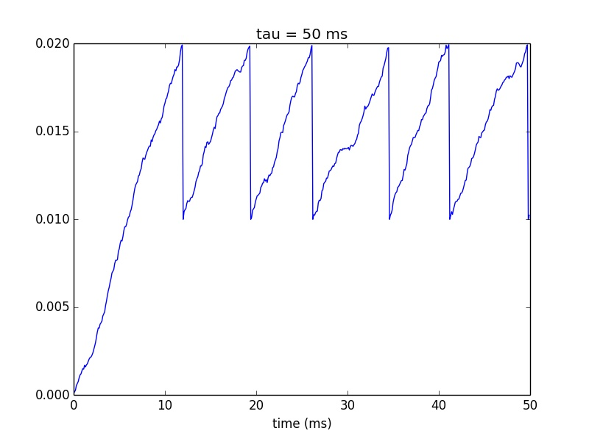
LIF neurons behavior
Example: influence of integration time (tau)

Slide 7
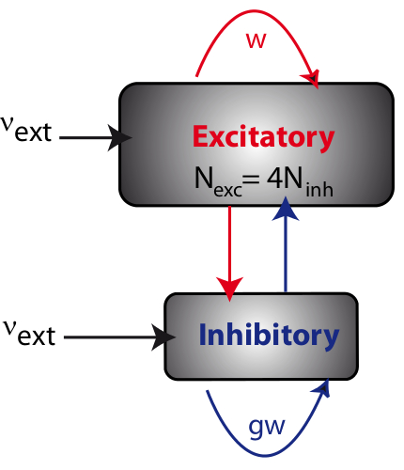
From LIF to a Balanced Network
Recurrent network
Excitatory : inhibitory neurons = 4:1
w = synaptic strength excitatory connections
g = relative weight inhibitory connections
Vext = frequency external input
From www.yger.net

Slide 8
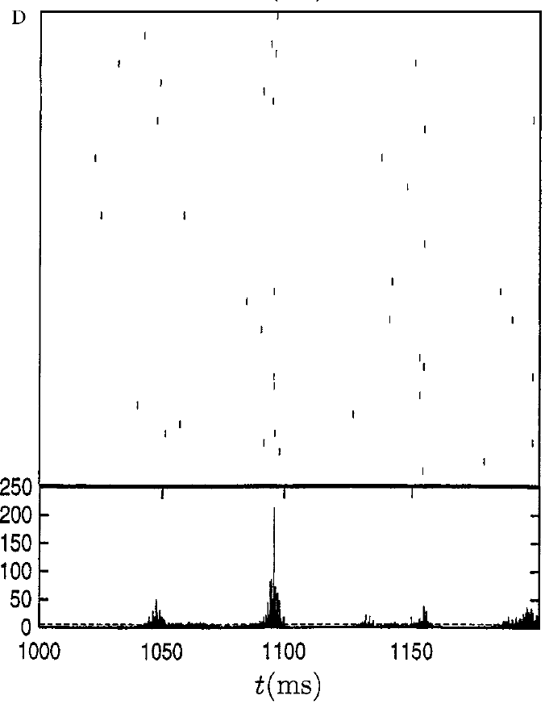
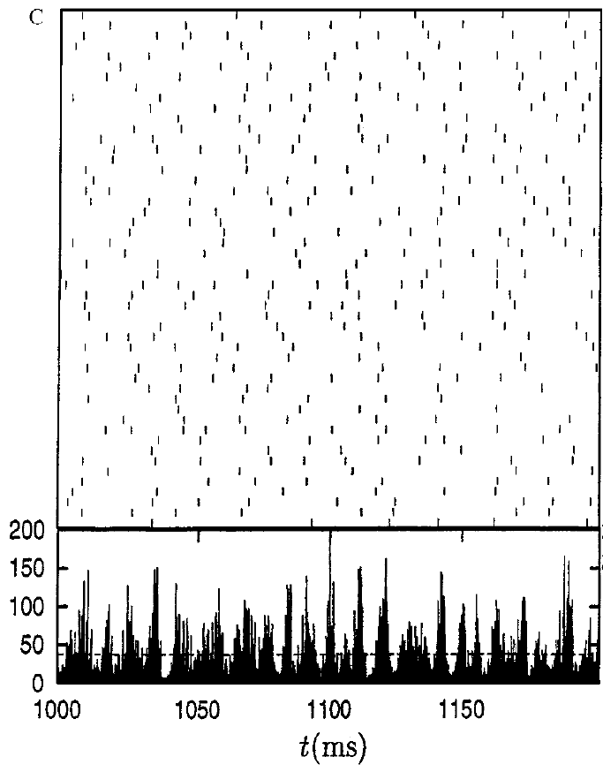
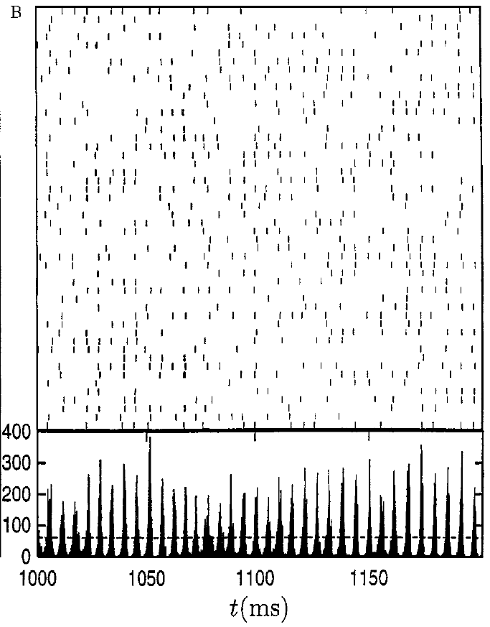
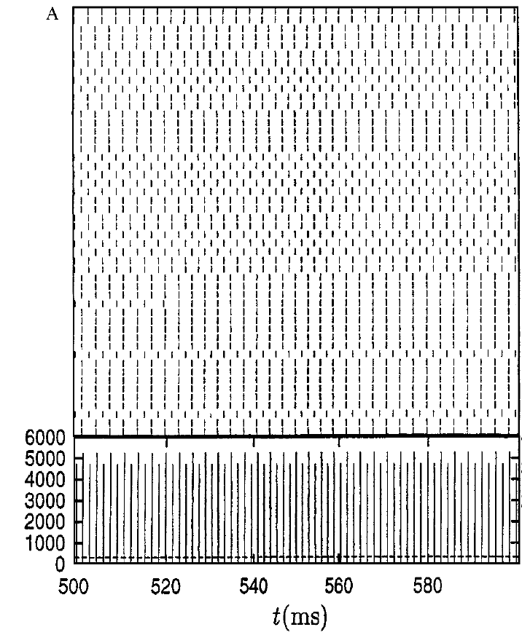
Balanced Network in different states
Balanced Network can reach 4 different states (Brunel, 2000)
States based on
Regularity of neuron
Synchrony of network
So 4 combinations:
Synchronous Regular (SR)
Synchronous Irregular (SI)
Asynchronous Regular (AR)
Asynchronous Irregular (AI)

Slide 9
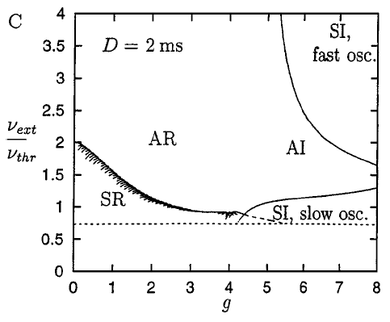
What causes different states?
Based on variations of 2 parameters:
External input (Vext)
Relative strength inhibitory synapse (g)

Slide 10
More complex model
Brunel (2000) simplest model
Yger (2013) more biological plausible model
Synapses described in more detail: after a spike, conductance decays over time
Reaches Asynchronous Irregular (AI) state
AI state similar to human cortical activity

Slide 11
Research question
Can a network model with more biological plausible synapses reach the same states as the original network with respect to synchrony and regularity.

Slide 12
Methods

Slide 13
Implementation of balanced network
BRAIN 2 simulator (Python)
800 excitatory and 200 inhibitory neurons
Sparseness of .1915
Stochastic external input
Free parameters:
Conductance of external input
Relative weight inhibitory synapses (g)

Slide 14
Quantification of Regularity and Synchrony
Objective measure for Regularity and Synchrony
Regularity of single neurons
Coefficient of Variation (CV):
For each neuron, the standard deviation of the Inter-spike-Interval distribution devided by the mean of this distribution
The CV of a network is the average of the CV of all its neurons
CV around 1 means highly irregular
CV close to 0 means highly regular

Slide 15
Quantification of Regularity and Synchrony
Objective measure for Regularity and Synchrony
Synchrony of network
Synchrony Measure (SM):
The average of 3 highest frequency peaks
With total amount of spikes random activity simulated
Average of 3 highest frequency peaks of random activity
SM = average of network devided by average of random activity
High SM means more synchrony

Slide 16
Clustering
Objectively cluster parameter sets in different states
K-means clustering

Slide 17
Results

Slide 18
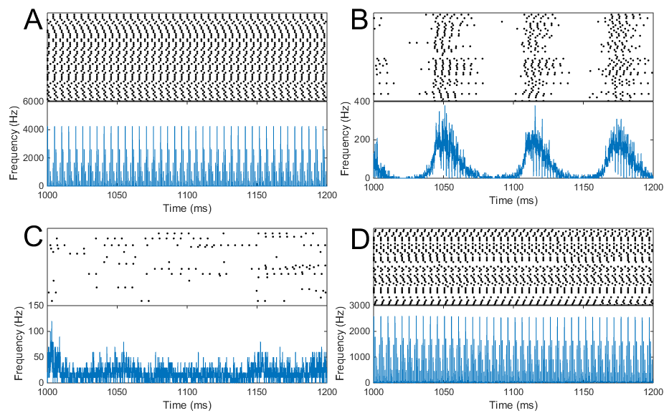
4 different states visible

Slide 19
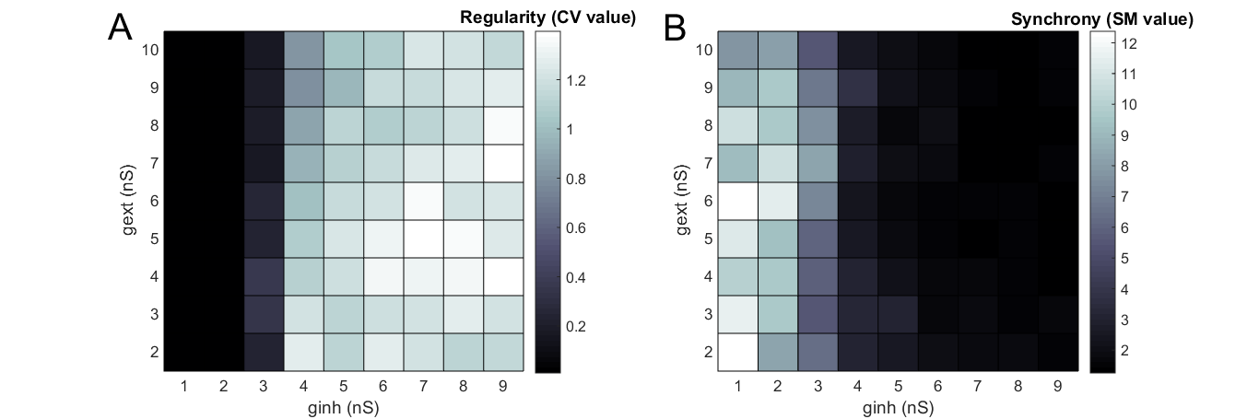
Quantification of Regularity

Slide 20
Quantification of Synchrony

Slide 21
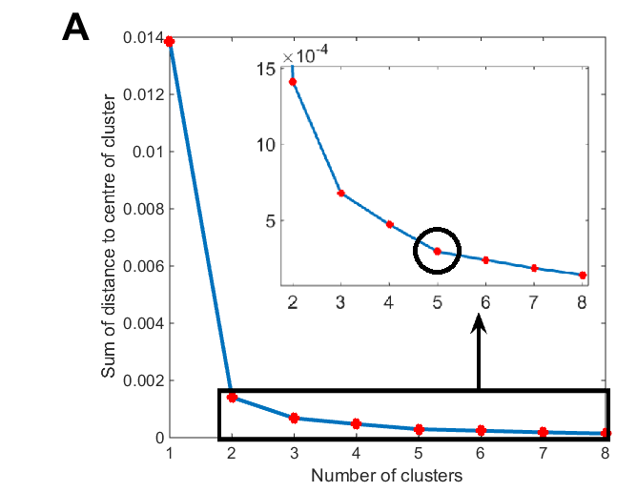
Clustering

Slide 22
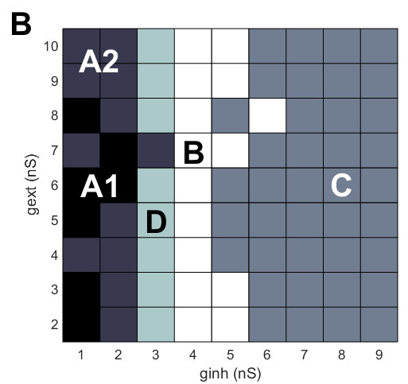
Clustering

Slide 23
4 different states visible

Slide 24
Discussion

Slide 25
Conclusion
The network model with more biological plausible synapses can reach different balanced states with respect to Regularity and Synchrony, but the behavior differs from the simpler network model, as there is strong bursting behavior.

Slide 26
Possible explanations
The more biological plausible synapse model
Dacay keeps membrane potential to threshold: bursting
Time constant of inhibitory synapse higher
Initial values of conductance differ
Transition State
Scaling

Slide 27
Why relevant?
Examine influence biological relevant properties
Synaptic strength
Connectivity of brain area
Length of axons/ dendrites
Especially on Asynchronous Irregular State
Epilepsy
Extend with more biological realistic components
Growth computational power

Slide 28
Take home
The model examined can simulate activity resembling human cortical activity.
Future studies can use this model, and extentions of it, to examine influence of biologically relevant properties
Therefore get more insight in computations underlying human cortical activity

Slide 29
Questions

